Slide 1
An Innovative Technology That Answers the Question:
> How Do I Get To An Address? <
FASTER
CHEAPER
EASIER
The answer is DIGITAL.
And we invented an App for it, it’s called:
… digitise your address
www.findgridcode.com

Slide 2
GridCodes®
What is GridCodes Technology?
What does it do?
It is a tool for digital addressing, deliverdd as a freely downloadable Mobile App
It converts any address into a set of SMART codes that become the DIGITAL address of that location
US Copyright Global
Patent #: TXu 2-153-410
How does it do it?
It synthesises GPS tech, smartphone tech, number sequencing algorithm & the earth’s long/lat coordinate system
www.findgridcode.com

Slide 3
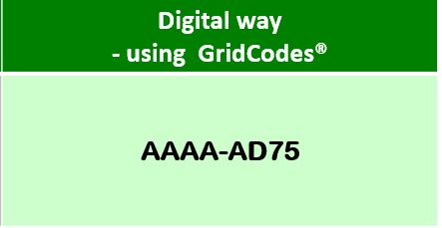
The future of addressing is here >>
Traditional way of locating a place – today’s method | Digital way - using GridCodes®
Locating Aminata’s Restaurant Address description: Aminata’s Lounge, near Kabeza Mall Bar, off Airport Road, by SP Petrol Station Corner, off Remera-Giporoso Junction, Kigali, Rwanda. (It’s the immediate right turn after the junction, it has a black). You can call 0783195787 for further directions | AAAA-AD75
…digitise your address
www.findgridcode.com

Slide 4
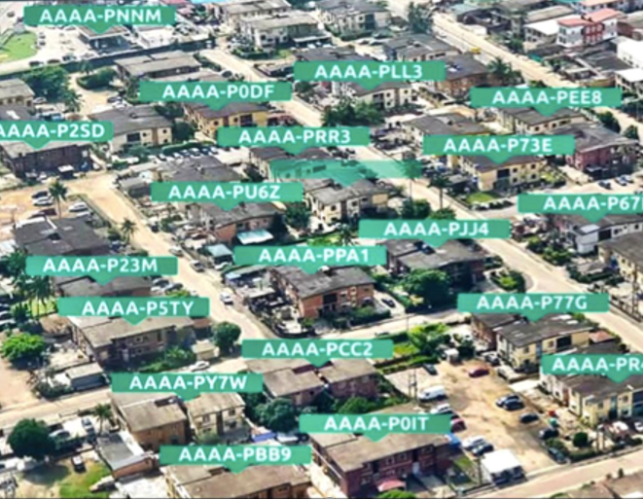

Slide 5
(a 60-second intro video clip)
www.findgridcode.com

Slide 6
> Practical Demo <
(a 3-minute practical demonstration of the power of GridCodes)
www.findgridcode.com

Slide 7
Some real-life applications of this innovative technology:
Last mile delivery of mails & courier
eCommerce & home delivery service
Property addressing & urban development
Security & emergency services / first responders
Drone delivery service & operations
Smart cities development and administration
Is currently deployed in Nigeria & Rwanda.
Ready to partner with all of the EA community
to achieve smart addressing & digitization goals
in line with UPU standards
www.ipositaondemand.rw
www.findgridcode.com

Slide 8
… digitise your address
Thank you for your time!
> Q & A <
www.findgridcode.com

